Slide 1

Unified modeling language (uml)
SOFTWARE ENGINEERING
SPRING 2021

Slide 2
uml
Unified Modeling Language, is a standardized modeling language consisting of an integrated set of diagrams, developed to help system and software developers for specifying, visualizing, constructing, and documenting the artifacts of software systems, as well as for business modeling and other non-software systems. The UML represents a collection of best engineering practices that have proven successful in the modeling of large and complex systems. The UML is a very important part of developing object oriented software and the software development process.
The UML uses mostly graphical notations to express the design of software projects. Using the UML helps project teams communicate, explore potential designs, and validate the architectural design of the software.

Slide 3
The origin of uml
The goal of UML is to provide a standard notation that can be used by all object-oriented methods and to select and integrate the best elements of precursor notations. UML has been designed for a broad range of applications. Hence, it provides constructs for a broad range of systems and activities (e.g., distributed systems, analysis, system design and deployment).

Slide 4
The origin of uml
UML is a notation that resulted from the unification of OMT from
Object Modeling Technique OMT [James Rumbaugh 1991] - was best for analysis and data-intensive information systems.
Booch [Grady Booch 1994] - was excellent for design and implementation. Grady Booch had worked extensively with the Ada language, and had been a major player in the development of Object Oriented techniques for the language. Although the Booch method was strong, the notation was less well received (lots of cloud shapes dominated his models - not very tidy)
OOSE (Object-Oriented Software Engineering [Ivar Jacobson 1992]) - featured a model known as Use Cases. Use Cases are a powerful technique for understanding the behaviour of an entire system (an area where OO has traditionally been weak).

Slide 5
The origin of uml
In 1994, Jim Rumbaugh, the creator of OMT, stunned the software world when he left General Electric and joined Grady Booch at Rational Corp. The aim of the partnership was to merge their ideas into a single, unified method (the working title for the method was indeed the "Unified Method").
By 1995, the creator of OOSE, Ivar Jacobson, had also joined Rational, and his ideas (particularly the concept of "Use Cases") were fed into the new Unified Method - now called the Unified Modelling Language1. The team of Rumbaugh, Booch and Jacobson are affectionately known as the "Three Amigos"

Slide 6
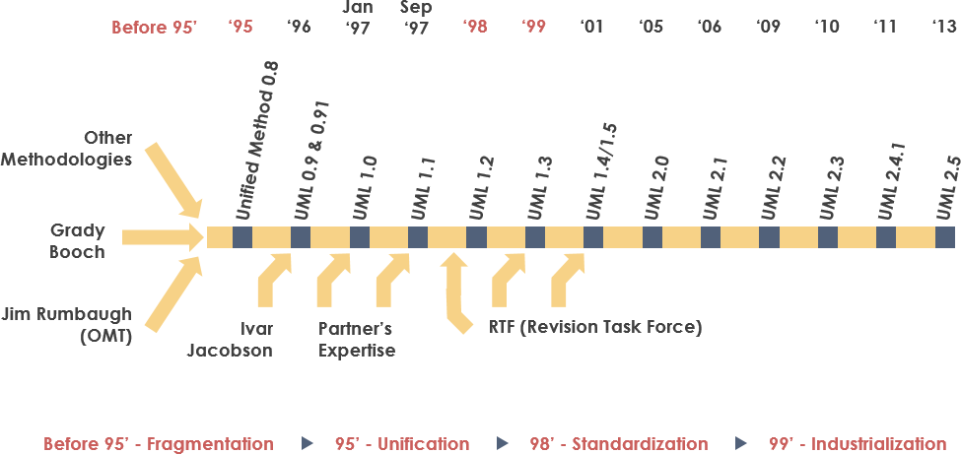
History of uml

Slide 7
Uml is influenced by other oo notations
Mellor and Shlaer [1998]
Coad and Yourdon [1995]
Wirfs-Brock [1990]
Martin and Odell [1992]

Slide 8
overview
The first thing to notice about the UML is that there are a lot of different diagrams (models) to get used to. The reason for this is that it is possible to look at a system from many different viewpoints. A software development will have many stakeholders playing a part.
For Example:
Analysts
Designers
Coders
Testers
QA
The Customer
Technical Authors

Slide 9
overview
All of these people are interested in different aspects of the system, and each of them require a different level of detail. For example, a coder needs to understand the design of the system and be able to convert the design to a low level code. By contrast, a technical writer is interested in the behavior of the system as a whole, and needs to understand how the product functions. The UML attempts to provide a language so expressive that all stakeholders can benefit from at least one UML diagram.

Slide 10
13 UML DIAGRAMS - structure
Structure diagrams show the static structure of the system and its parts on different abstraction and implementation levels and how they are related to each other. The elements in a structure diagram represent the meaningful concepts of a system, and may include abstract, real world and implementation concepts, there are seven types of structure diagram as follows:
Class Diagram
Component Diagram
Deployment Diagram
Object Diagram
Package Diagram
Composite Structure Diagram
Profile Diagram

Slide 11
13 UML DIAGRAMS - behavior
Behavior diagrams show the dynamic behavior of the objects in a system, which can be described as a series of changes to the system over time, there are seven types of behavior diagrams as follows:
Use Case Diagram
Activity Diagram
State Machine Diagram
Sequence Diagram
Communication Diagram
Interaction Overview Diagram
Timing Diagram

Slide 12
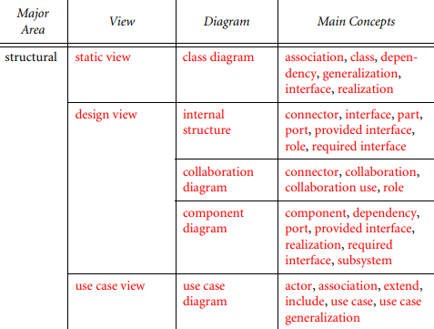
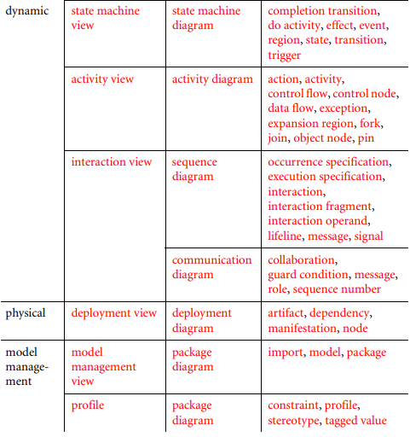
UML VIEWS

Slide 13
Use-case diagrams
Use-case diagrams capture the functionality of a system. The use-cases in these diagrams show some high-level functionalities in a system.

Slide 14
Notations/elements in a use-case diagram
ACTORS
USE-CASES
RELATIONSHIPS

Slide 15
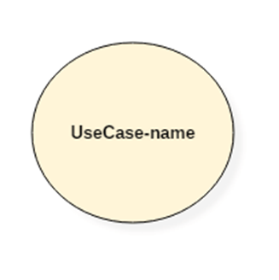
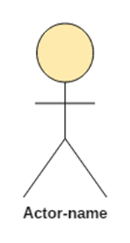
ELEMENTS OF USE-CASE/NOTATIONS

Slide 16
RELATIONSHIPS
Association between actor and use case
Generalization of an actor
Extend between two use cases
Include between two use cases
Generalization of a use case

Slide 17
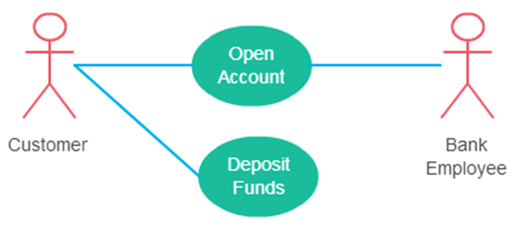
ASSOCIATION

Slide 18
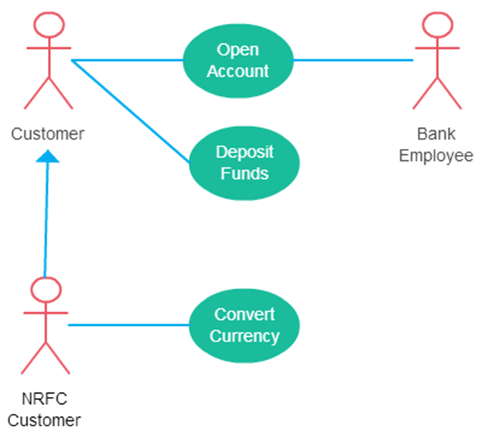
GENERALIZATION (ACTOR)

Slide 19
EXTEND
Many people confuse the extend relationship in use cases. As the name implies it extends the base use case and adds more functionality to the system. Here are a few things to consider when using the <<extend>> relationship.
The extending use case is dependent on the extended (base) use case. In the below diagram the “Calculate Bonus” use case doesn’t make much sense without the “Deposit Funds” use case.
The extending use case is usually optional and can be triggered conditionally. In the diagram, you can see that the extending use case is triggered only for deposits over 10,000 or when the age is over 55.
The extended (base) use case must be meaningful on its own. This means it should be independent and must not rely on the behavior of the extending use case.

Slide 20
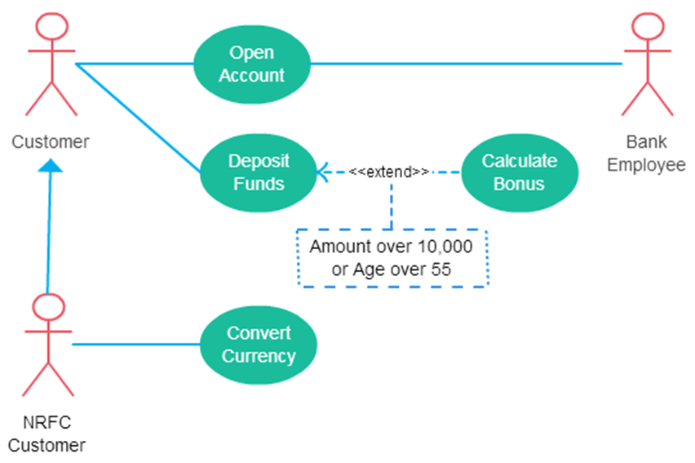
EXTEND - EXAMPLE

Slide 21
INCLUDE
Include relationship show that the behavior of the included use case is part of the including (base) use case. The main reason for this is to reuse common actions across multiple use cases. In some situations, this is done to simplify complex behaviors. Few things to consider when using the <<include>> relationship.
The base use case is incomplete without the included use case.
The included use case is mandatory and not optional.

Slide 22
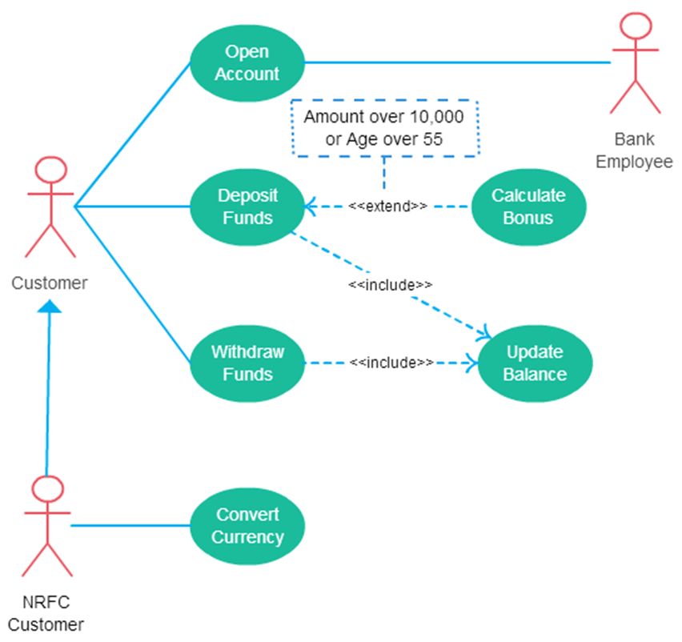
INCLUDE - EXAMPLE

Slide 23
GENERALIZATION – USE-CASE
This is similar to the generalization of an actor. The behavior of the ancestor is inherited by the descendant. This is used when there is common behavior between two use cases and also specialized behavior specific to each use case.
For example, in the previous banking example, there might be a use case called “Pay Bills”. This can be generalized to “Pay by Credit Card”, “Pay by Bank Balance” etc.

Slide 24
Class diagrams
A Class in UML diagram is a blueprint used to create an object or set of objects. The Class defines what an object can do. It is a template to create various objects and implement their behavior in the system. A Class in UML is represented by a rectangle that includes rows with class names, attributes, and operations.
A Class Diagram in Software engineering is a static structure that gives an overview of a software system by displaying classes, attributes, operations, and their relationships between each other. This Diagram includes the class name, attributes, and operation in separate designated compartments. Class Diagram helps construct the code for the software application development.

Slide 25
Class diagrams
Class Diagram defines the types of objects in the system and the different types of relationships that exist among them. It gives a high-level view of an application. This modeling method can run with almost all Object-Oriented Methods. A class can refer to another class. A class can have its objects or may inherit from other classes.

Slide 26
Essential elements of a class diagram
Class Name
Attributes
Operations

Slide 27
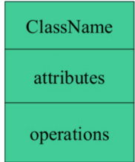
Elements of class diagram

Slide 28
NAME OF A CLASS
The name of the class is only needed in the graphical representation of the class. It appears in the topmost compartment. A class is the blueprint of an object which can share the same relationships, attributes, operations, & semantics. The class is rendered as a rectangle, including its name, attributes, and operations in sperate compartments.

Slide 29
RULES TO NAME A CLASS
A class name should always start with a capital letter.
A class name should always be in the center of the first compartment.
A class name should always be written in bold format.
UML abstract class name should be written in italics format.

Slide 30
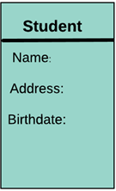
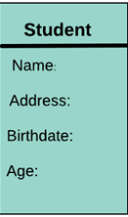
ATTRIBUTES
An attribute is named property of a class which describes the object being modeled. In the class diagram, this component is placed just below the name-compartment.
A derived attribute is computed from other attributes. For example, an age of the student can be easily computed from his/her birth date.

Slide 31
RELATIONSHIPS
Dependencies
Generalizations
Associations

Slide 32

dependency
A dependency means the relation between two or more classes in which a change in one may force changes in the other. However, it will always create a weaker relationship. Dependency indicates that one class depends on another.
In this UML class diagram examples, Student has a dependency on College

Slide 33
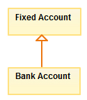
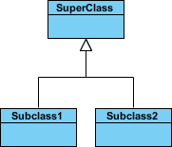
generalization
A generalization helps to connect a subclass to its superclass. A sub-class is inherited from its superclass. Generalization relationship can't be used to model interface implementation. Class diagram allows inheriting from multiple superclasses.
For example, the class Student is generalized from Person Class.
Generalization is another name for inheritance or an "is a" relationship. It refers to a relationship between two classes where one class is a specialized version of another. For example, Honda is a type of car. So the class Honda would have a generalization relationship with the class car.

Slide 34
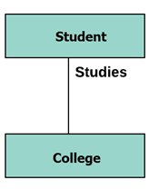
association
This kind of relationship represents static relationships between classes A and B. For example; an employee works for an organization.
Here are some rules for Association:
Association is mostly verb or a verb phrase or noun or noun phrase.
It should be named to indicate the role played by the class attached at the end of the association path.
Mandatory for reflexive associations
In this example, the relationship between student and college is shown which is studies.

Slide 35
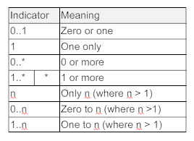
Multiplicity (cardinality)
How many objects of each class take part in the relationships and multiplicity can be expressed as:
Exactly one - 1
Zero or one - 0..1
Many - 0..* or *
One or more - 1..*
Exact Number - e.g. 3..4 or 6
Or a complex relationship - e.g. 0..1, 3..4, 6.* would mean any number of objects other than 2 or 5

Slide 36
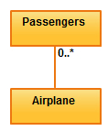
example
one fleet may include multiple airplanes, while one commercial airplane may contain zero to many passengers. The notation 0..* in the diagram means “zero to many”.

Slide 37

aggregation
Aggregation is a special type of association that models a whole- part relationship between aggregate and its parts.
For example, the class college is made up of one or more student. In aggregation, the contained classes are never totally dependent on the lifecycle of the container. Here, the college class will remain even if the student is not available.

Slide 38

composition
The composition is a special type of aggregation which denotes strong ownership between two classes when one class is a part of another class.
For example, if college is composed of classes student. The college could contain many students, while each student belongs to only one college. So, if college is not functioning all the students also removed.

Slide 39
Aggregation v/s composition
Composition is a special type of aggregation that denotes a strong ownership between Class A, the whole, and Class B, its part. Illustrate composition with a filled diamond. Use a hollow diamond to represent a simple aggregation relationship, in which the "whole" class plays a more important role than the "part" class, but the two classes are not dependent on each other. The diamond ends in both composition and aggregation relationships point toward the "whole" class (i.e., the aggregation).

Slide 40
Aggregation v/s composition

Slide 41
example
ATMs system is very simple as customers need to press some buttons to receive cash. However, there are multiple security layers that any ATM system needs to pass. This helps to prevent fraud and provide cash or need details to banking customers.

Slide 42
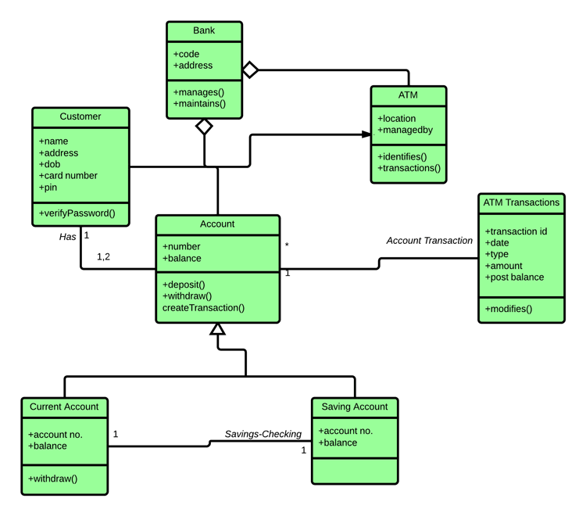
example

Slide 43
Perspectives of class diagram in sdlc
Class diagrams can be used in various software development phases. It helps in modeling class diagrams in three different perspectives.
1. Conceptual perspective: Conceptual diagrams are describing things in the real world. You should draw a diagram that represents the concepts in the domain under study. These concepts related to class and it is always language-independent.
2. Specification perspective: Specification perspective describes software abstractions or components with specifications and interfaces. However, it does not give any commitment to specific implementation.
3. Implementation perspective: This type of class diagrams is used for implementations in a specific language or application. Implementation perspective, use for software implementation.

Slide 44
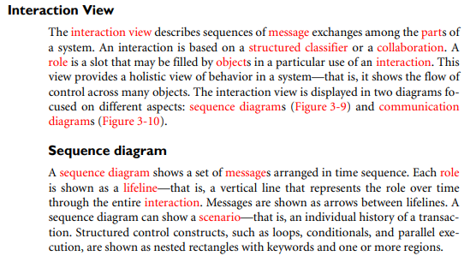

Slide 47

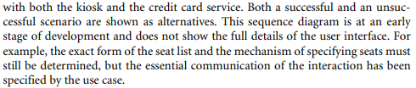

Slide 48
Basic symbols and components

Slide 49
Basic symbols and components

Slide 50
Basic symbols and components

Slide 51
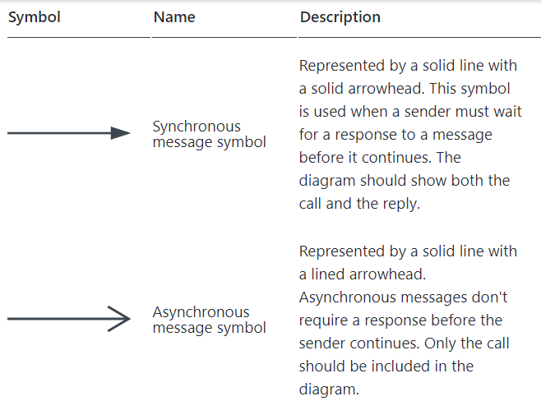
COMMON MESSAGE SYMBOLS

Slide 52
COMMON MESSAGE SYMBOLS
Notes:
https://creately.com/blog/diagrams/sequence-diagram-tutorial/

Slide 53
Thank you !! Best of luck….

